Slide 1
27/06 Test AstaZero track

Slide 2
Content
Red bike
Relevant tests
Conclusions
Green bike
Relevant tests
Conclusions

Slide 3
Red bike

Slide 4
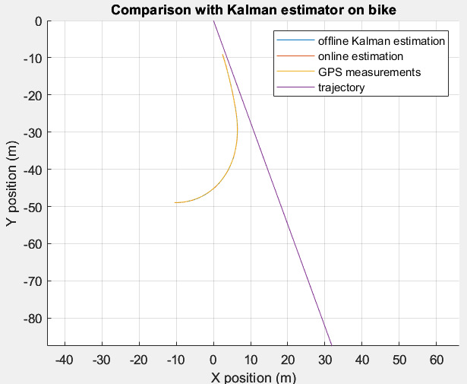
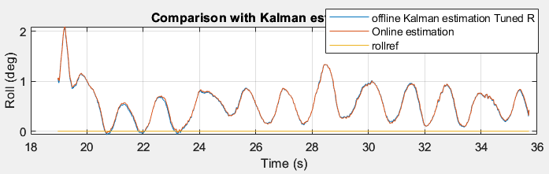
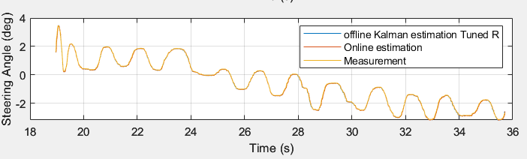
Balancing tests (Zero CONSTANT roll ref)
Trajectory
Roll and steering [deg]

Slide 5
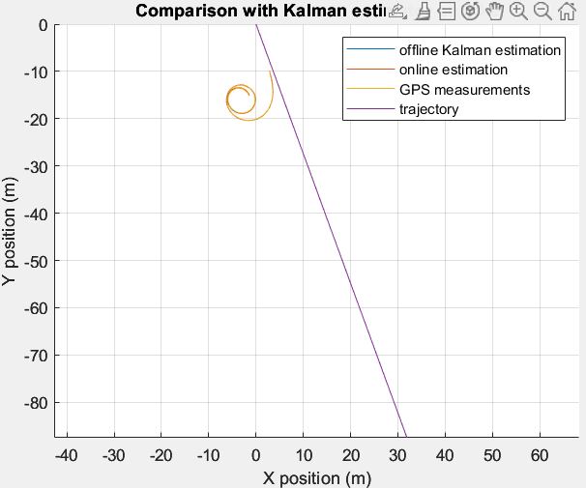
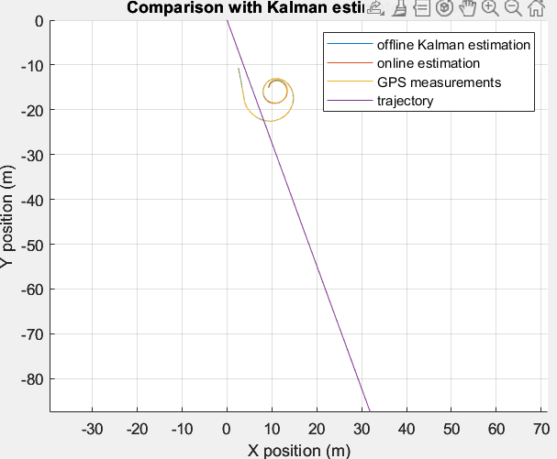
Balancing test (Non zero CONSTANT roll ref)
Roll ref +5 deg
Roll ref -5 deg
Notes:
Roll ref +5 deg data_3
Roll ref -5 deg data_4

Slide 6
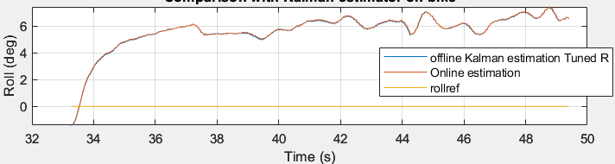
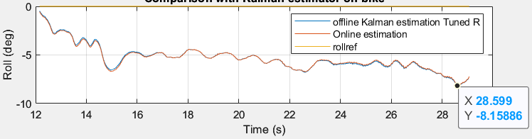
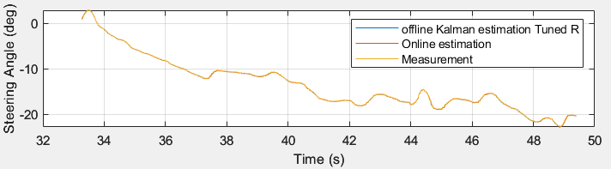
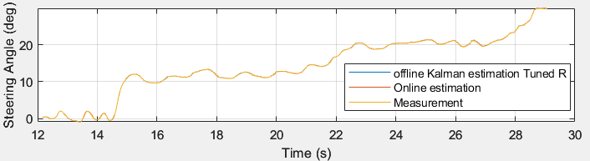
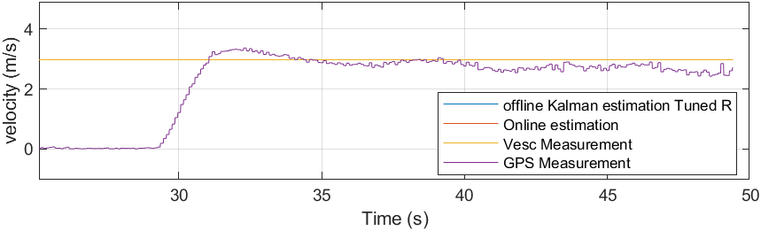
Roll ref +5 deg
Roll ref -5 deg

Slide 7
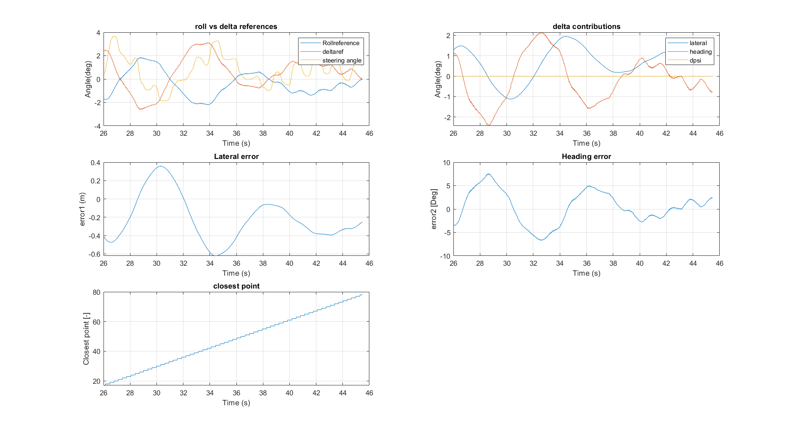
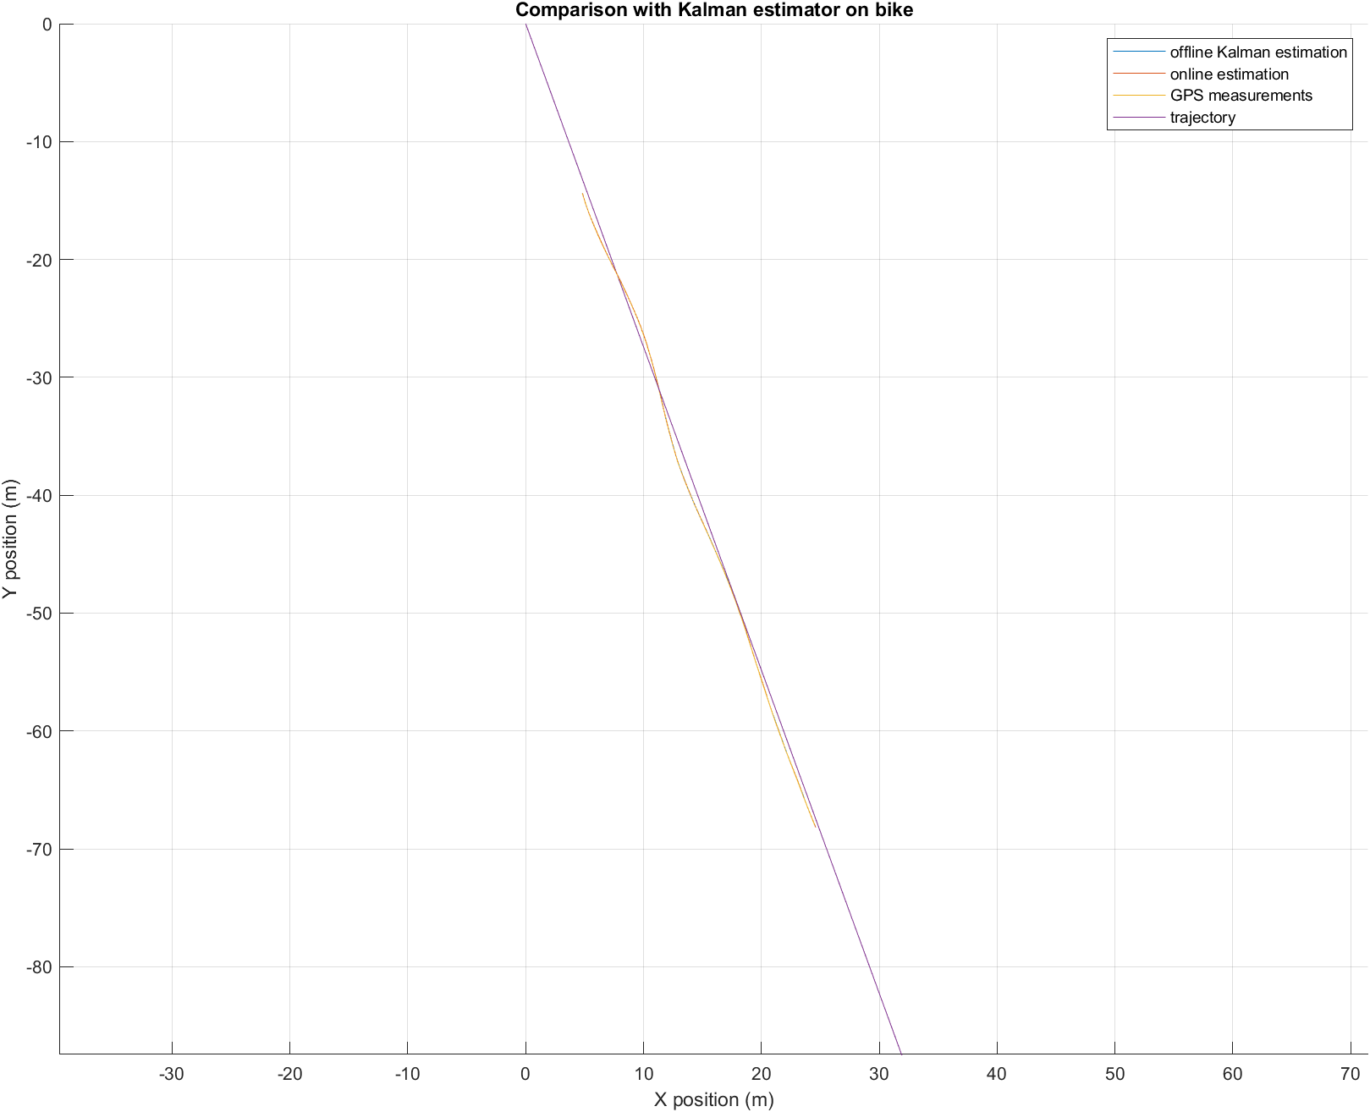
Straight line

Slide 8
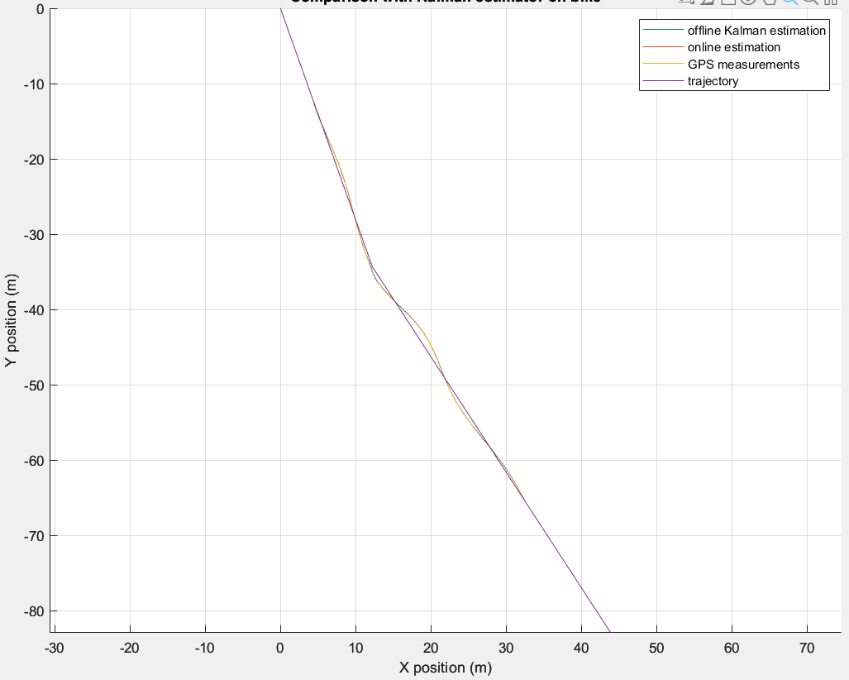
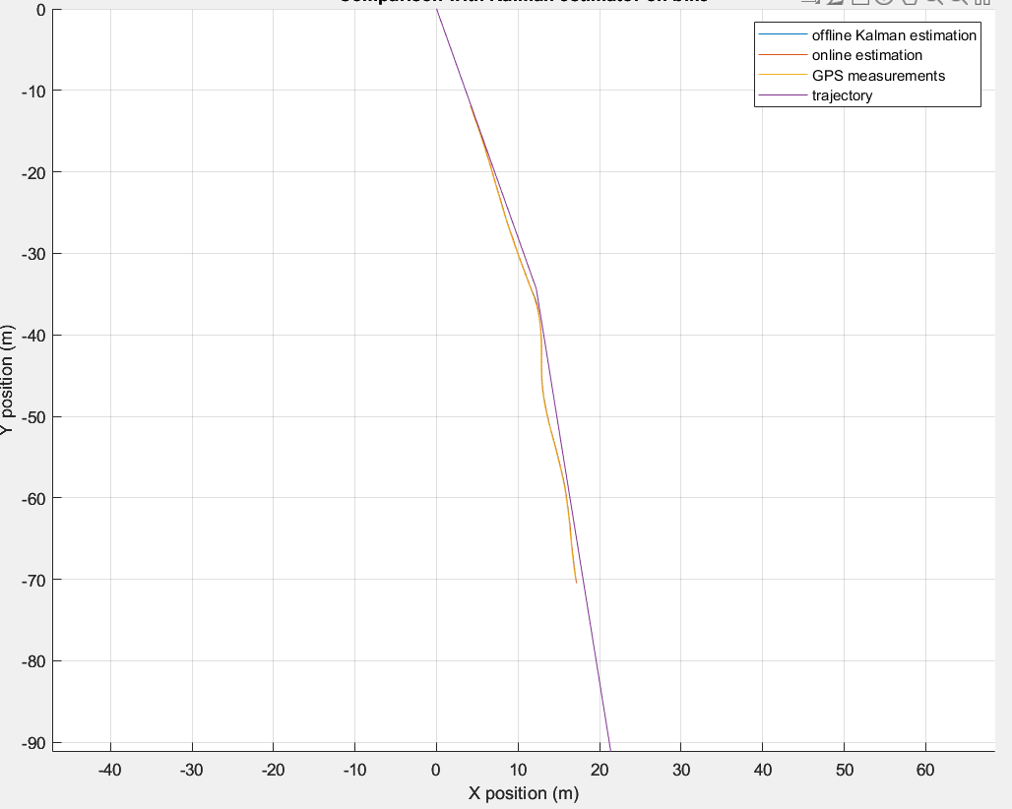
Straight + turn 10ᵒ approx (heading change)
Left
Right

Slide 9
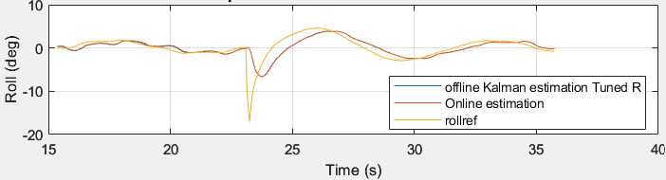
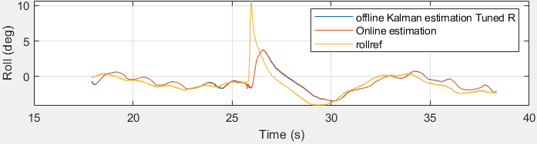
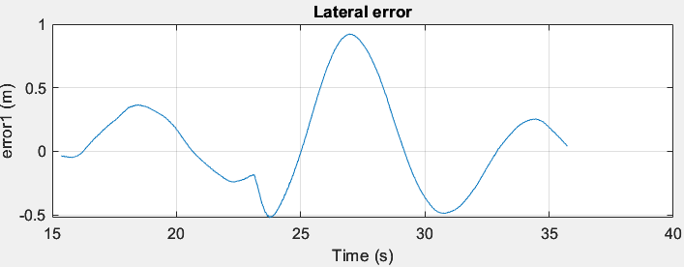
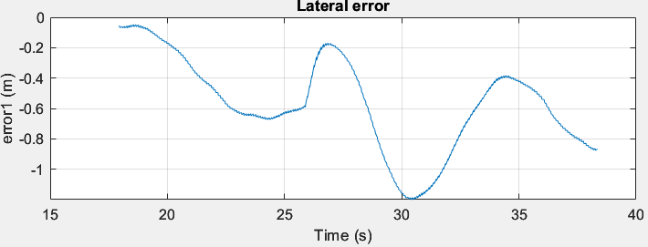
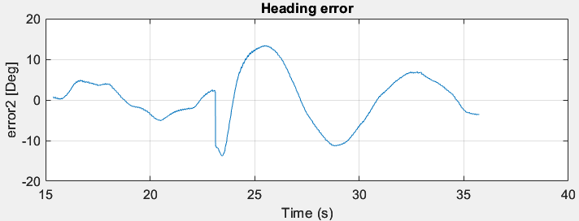
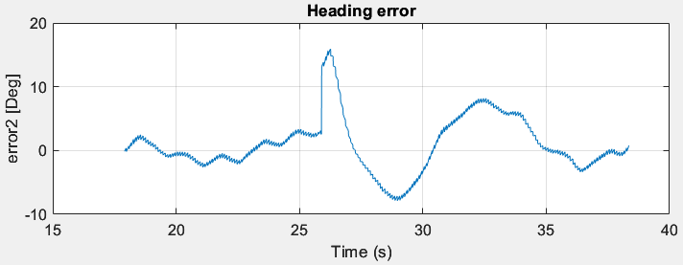
Left
Right

Slide 10
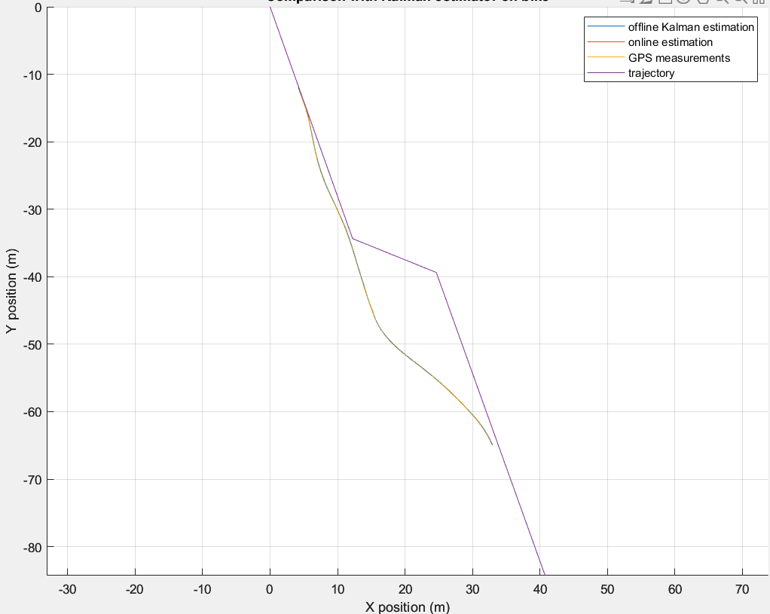
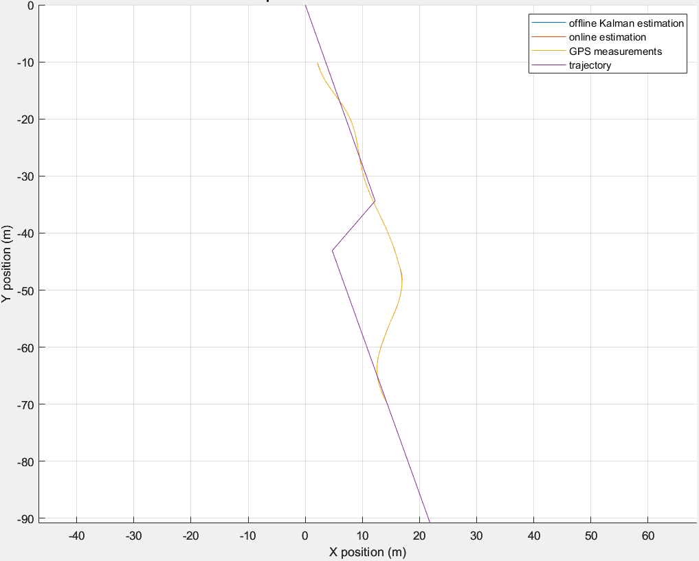
Straight + Lateral jump (Lateral error)
Left
Right

Slide 11
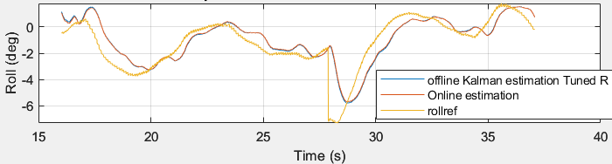
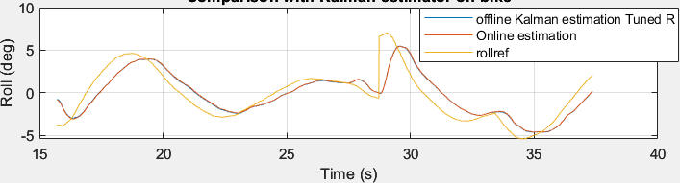
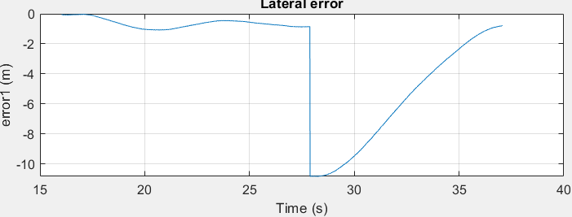
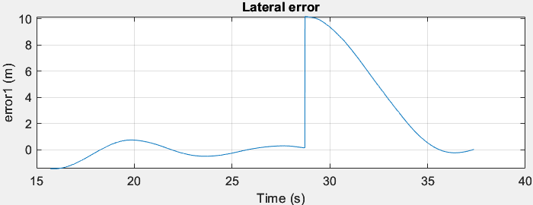
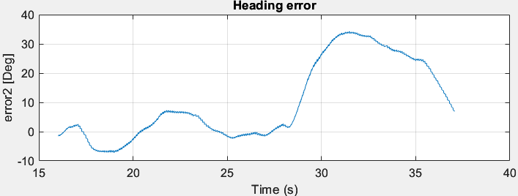
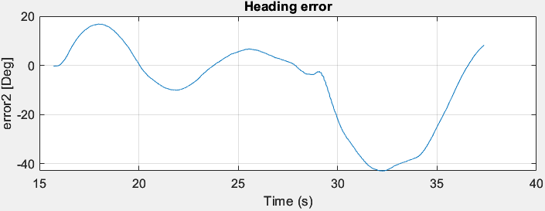
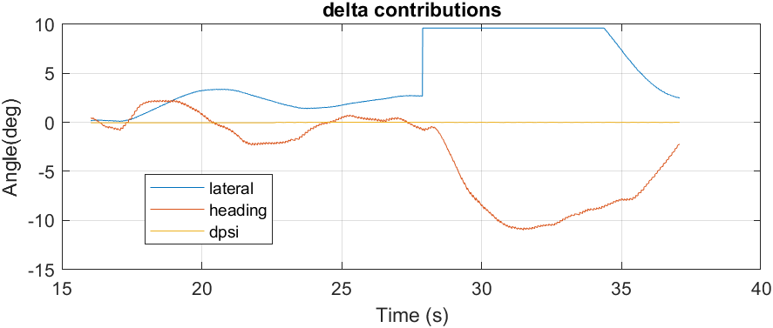
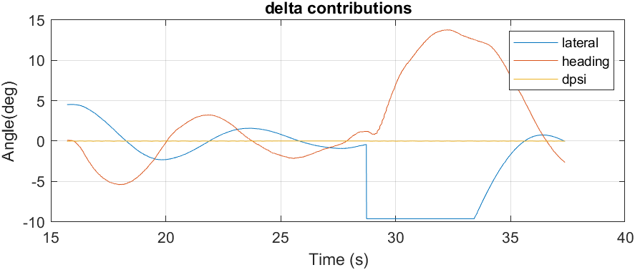
Right
Left

Slide 12
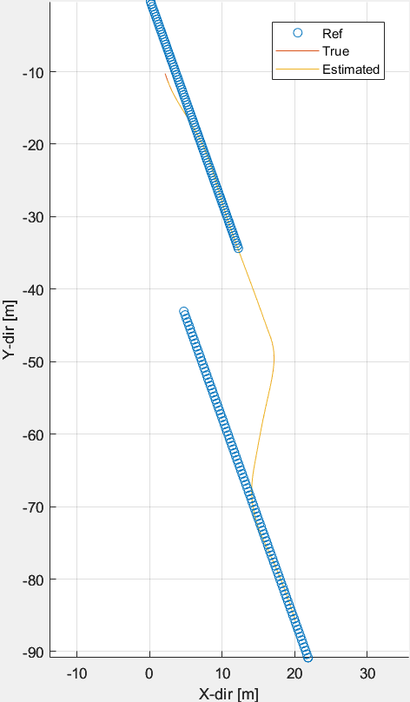
Compare simulation with reality
Simulation
Reality

Slide 13
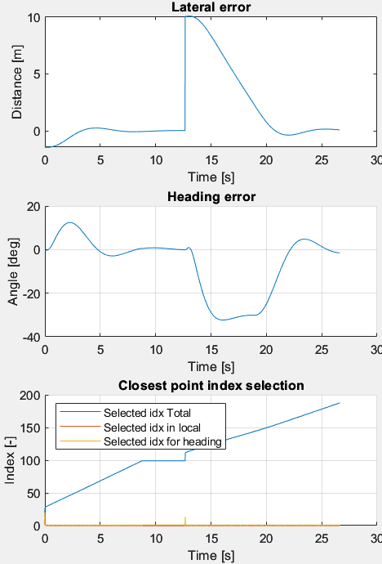
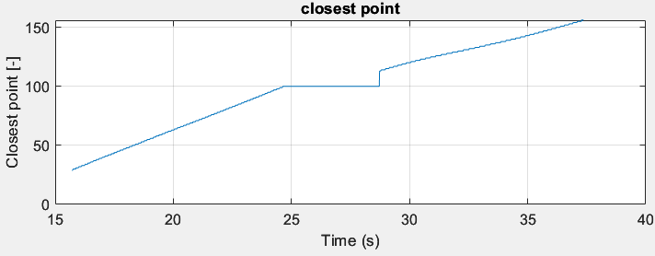
Compare simulation with reality
Simulation
Reality

Slide 14
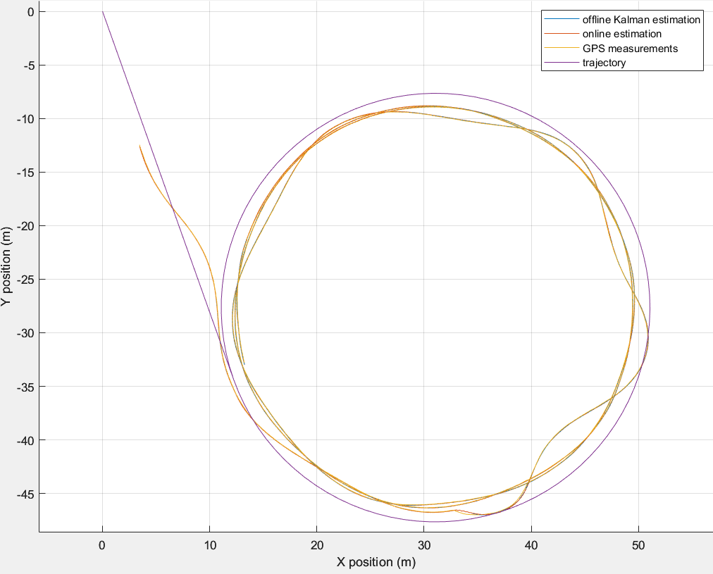
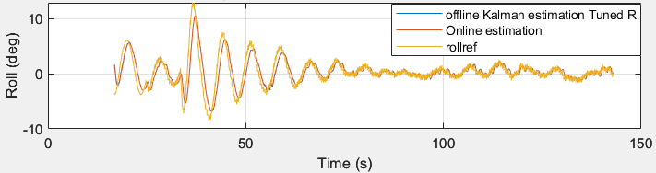
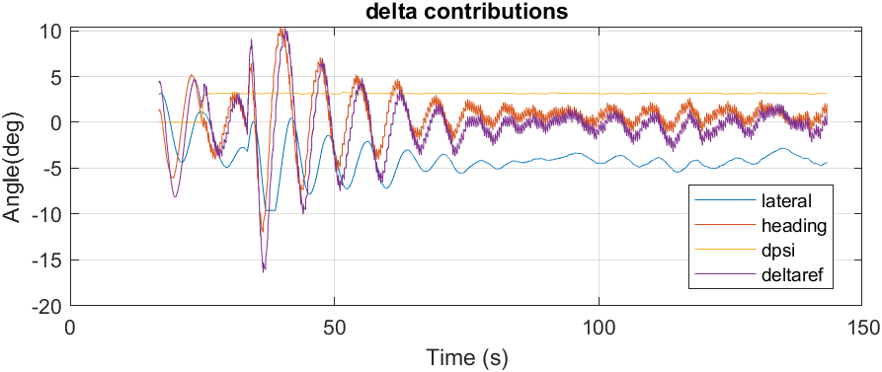
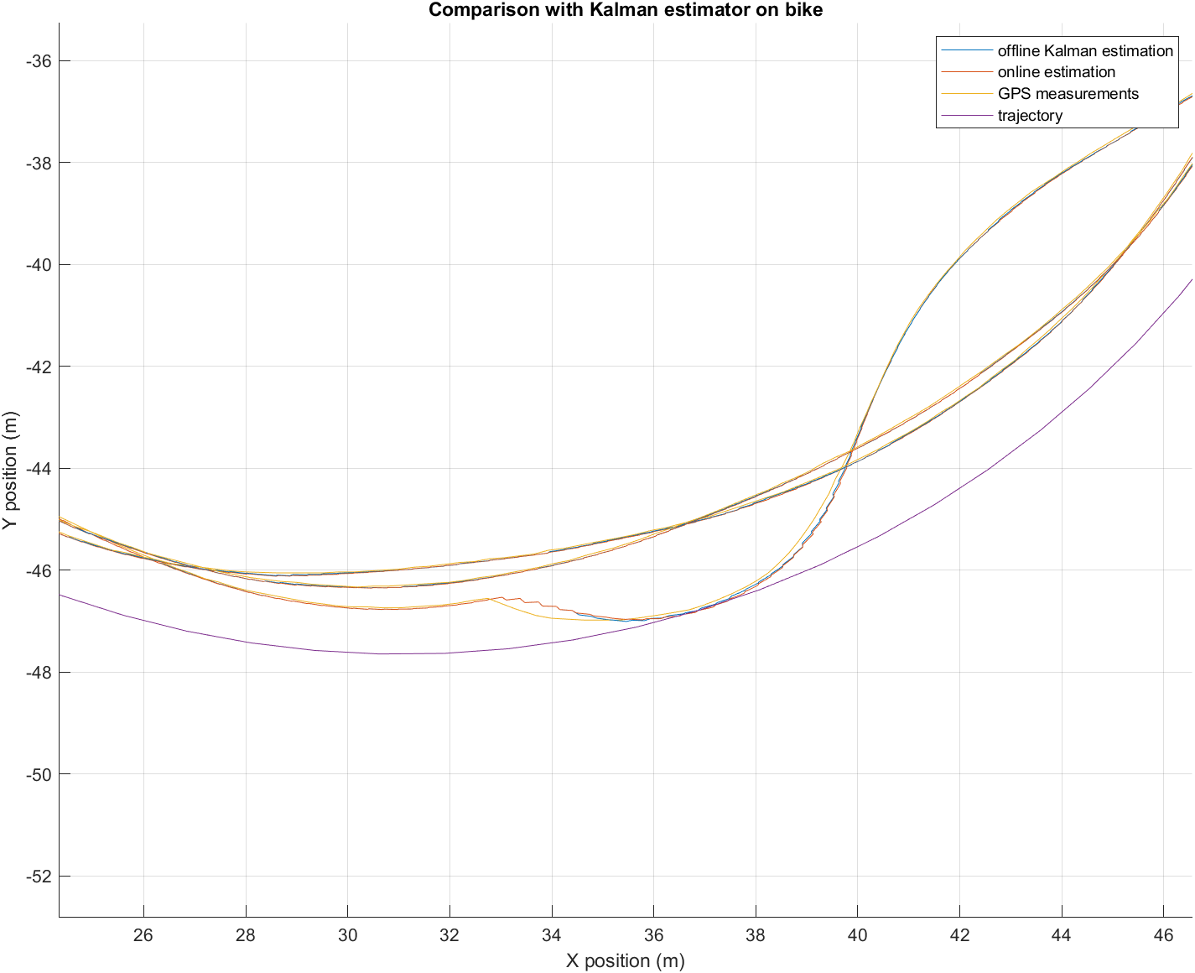
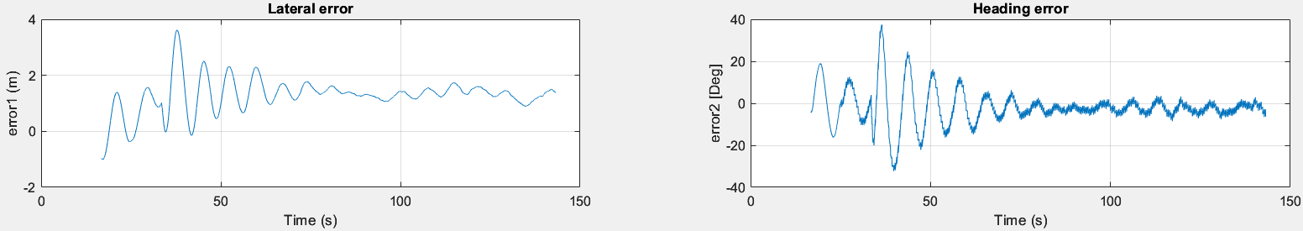
Straight + circle (3 laps, r = 20m, v = 3m/s)

Slide 15
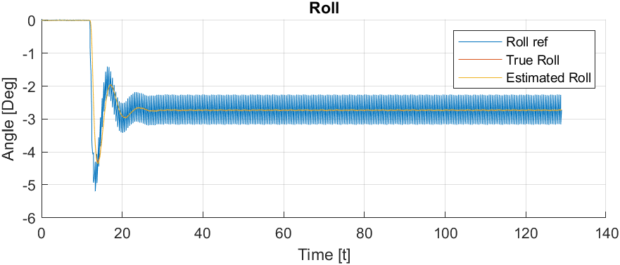

Slide 16
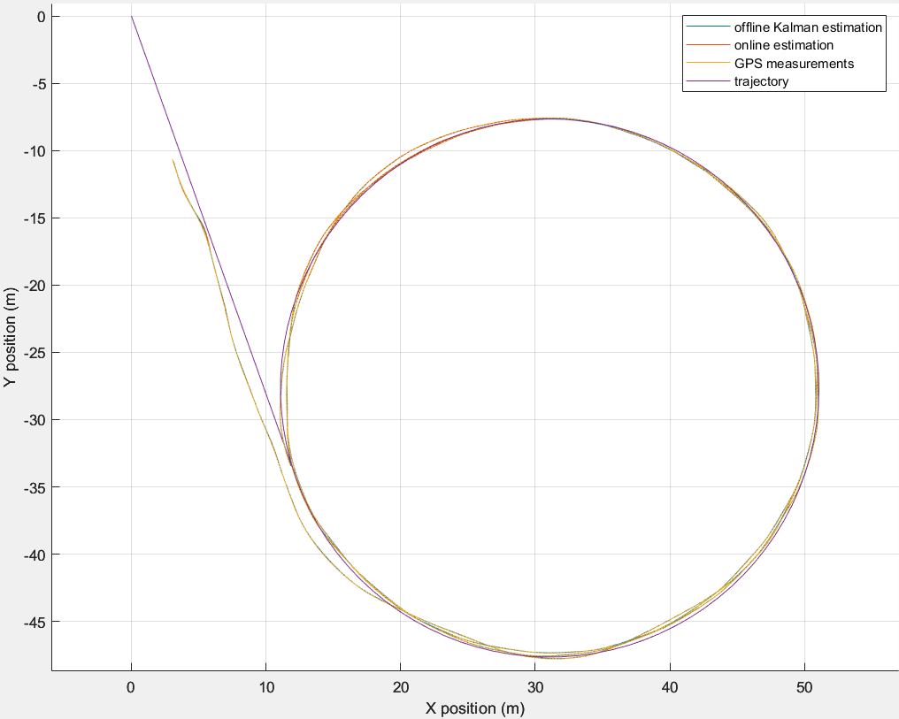
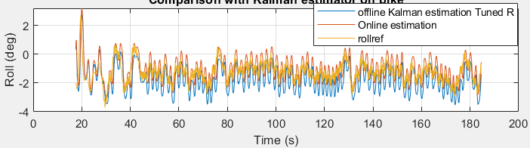
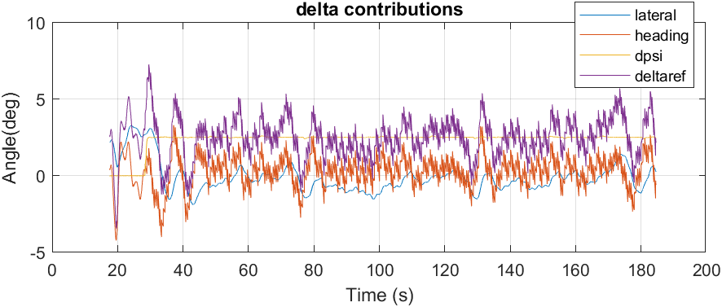
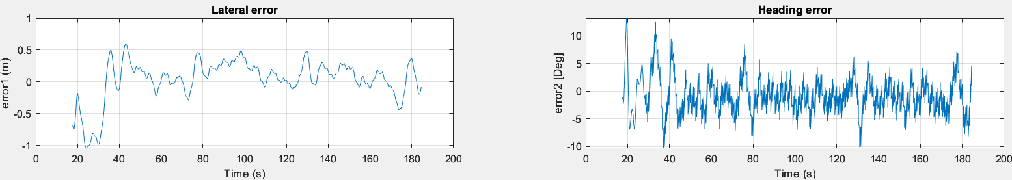
Straight + circle (3 laps, r = 20m, v = 2.4m/s)

Slide 17
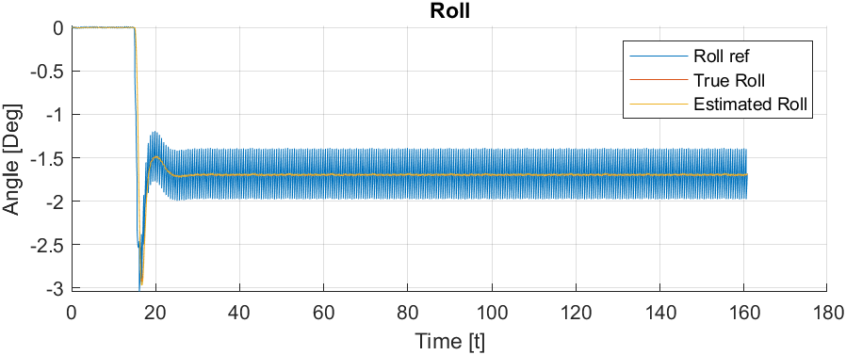

Slide 18
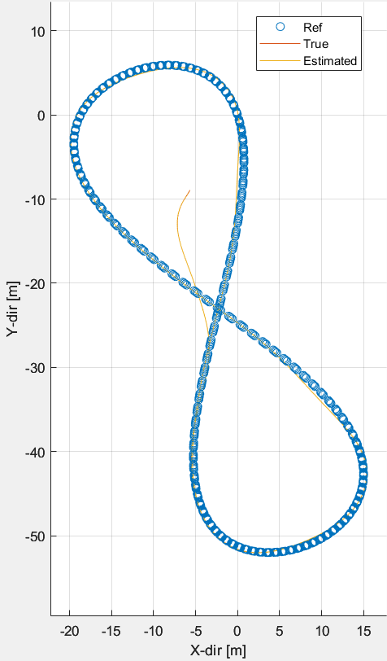
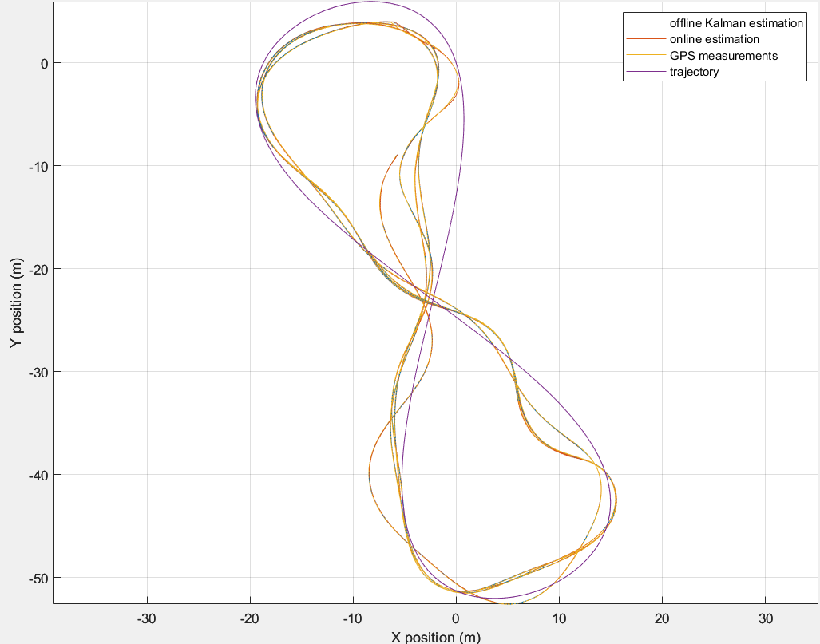
Infinite sim vs reality
Simulation
Reality

Slide 19
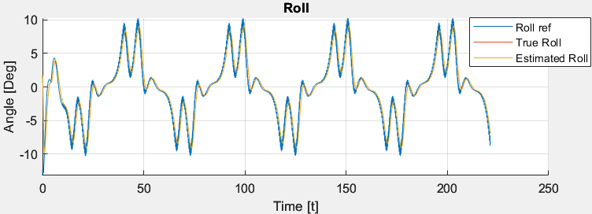
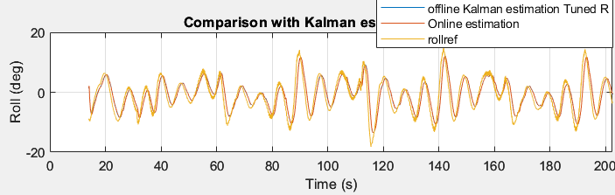
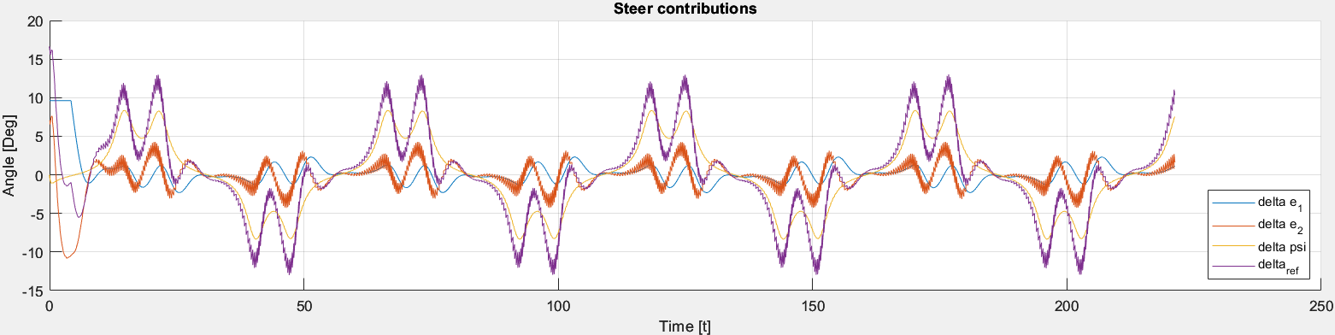
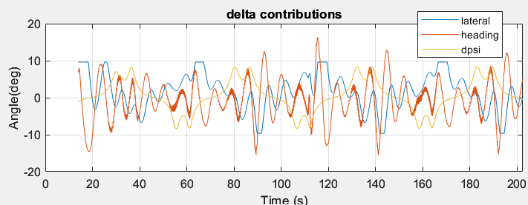
Simulation
Reality

Slide 20



Simulation
Reality

Slide 21
Future work
Improvement:
-Online trajectory reference direction, record two points with GPS for have the direction of the reference;
- Communication with the VESC, sometimes the velocity gets stuck to the the values of the previous test(motor write VI);
Warning signals/messages like:
1. Reach limit error (e1-e2). Improve the led signal in labview main VI;
2. GPS jumps (warning in matlab);
3. Stuck velocity for VESC;
4. Log data labview warning instead of matlab plot (no delay, correct frequency). (place to modify -> logging VI).
Understand differences between previous and actual GPS configuration (black bike);
Check or add new documentation about steering motor, GPS, drive motor configuration;
Improve Closest point algorithm if needed. (issue just on later error test);
Matrixmat and trajectorymat path in labview need to be updated automatically between different Vi’s;
Trajectory generator matlab algoritm -> circle and infinte improvements;
Test the constant roll after end of the trajectory to pick the bike (Labview -> trajectory control C-code ).

Slide 22
Green bike

Slide 23



Balancing test (Zero roll ref w disturbances)
Trajectory
Roll and steering angle [deg]

Slide 24




Straight line
Roll and steering [deg]
Trajectory

Slide 25




Straight + circle (3 laps, r = 20m, v = 3m/s)

Slide 26

Green bike schematic

